Slide 1


Team 71: Virtual Computer Mouse using mmWave Radar (TI) Bi-Weekly Update 1
Oscar Chavez Araiza
Greyson Heath
Daniel Lu
Zane Meikle
Sponsor: Texas Instruments
TA: Vishwam Raval

Slide 2
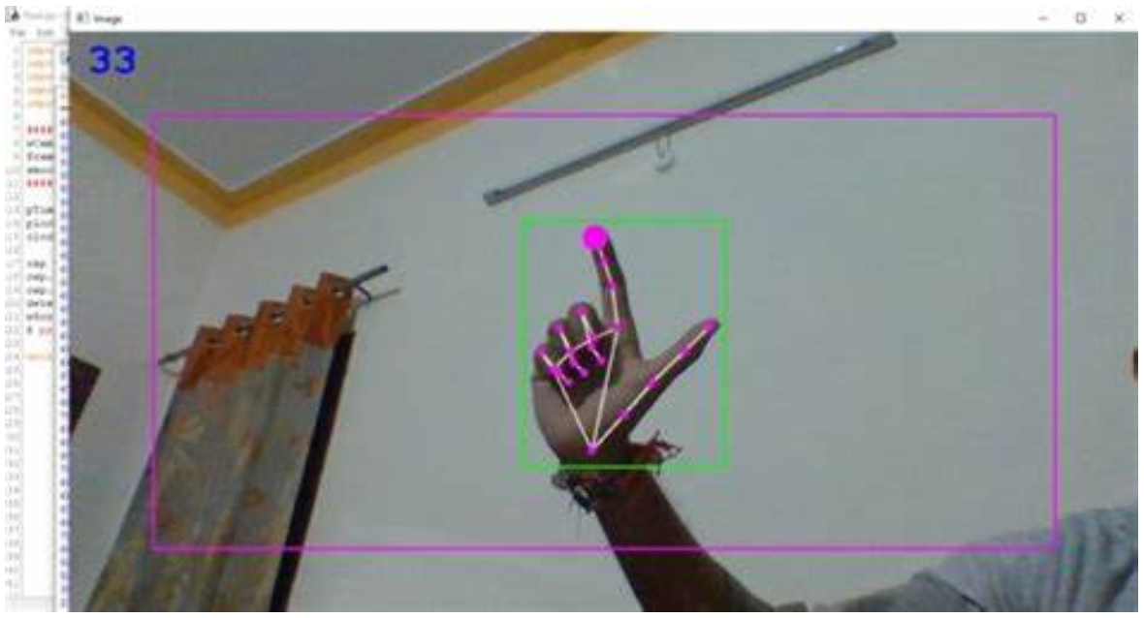
Project Summary:
Problem statement:
Virtual mice today are traditionally done using computer vision and a camera (as seen on the right).
But these systems are processing and power intensive.
High-level summary:
Create a virtual mouse using a Texas Instruments (TI) mmWave Radar and a ML model to make a less power and processing intensive virtual mouse.

Slide 3
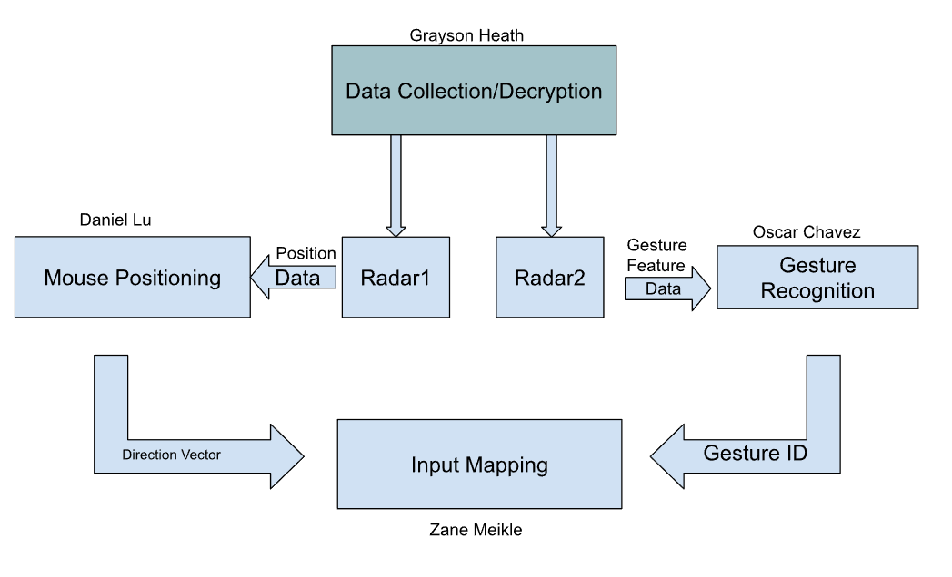
System Overview

Slide 4
Major Project Changes for 404
Currently, we are integrating what we have. Afterwards, we plan to do the following proposed changes:
Interactive GUI - Provides feedback and sensitivity adjustments (Greyson)
Improving AI for gestures - New gestures for holding clicks (Oscar)
Mouse frame smoothing - Connect point A to point B with arbitrary frames to smooth motion (Daniel)
Parallelization of scripts - Parallelize the different scripts so they aren't running in one program (Zane)
Radar enclosure case - Protects devices and looks presentable (Greyson)

Slide 5
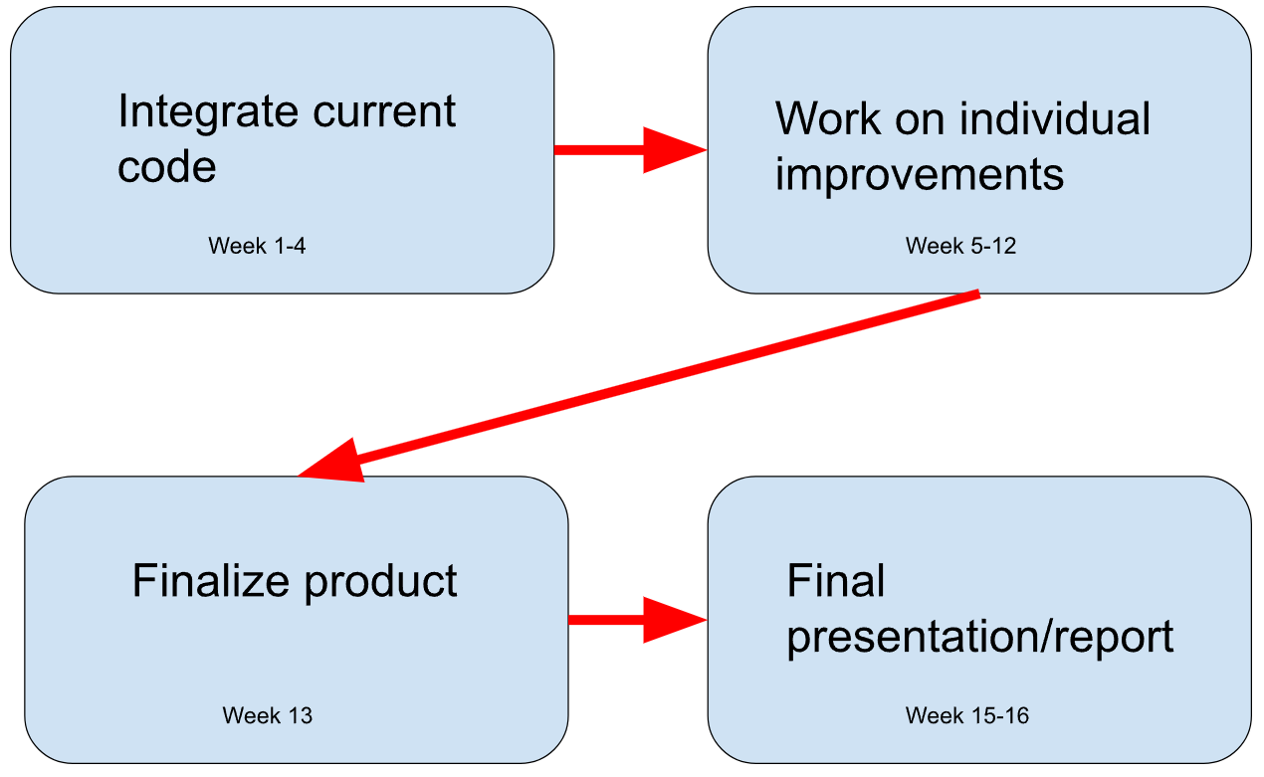
Project Timeline

Slide 6
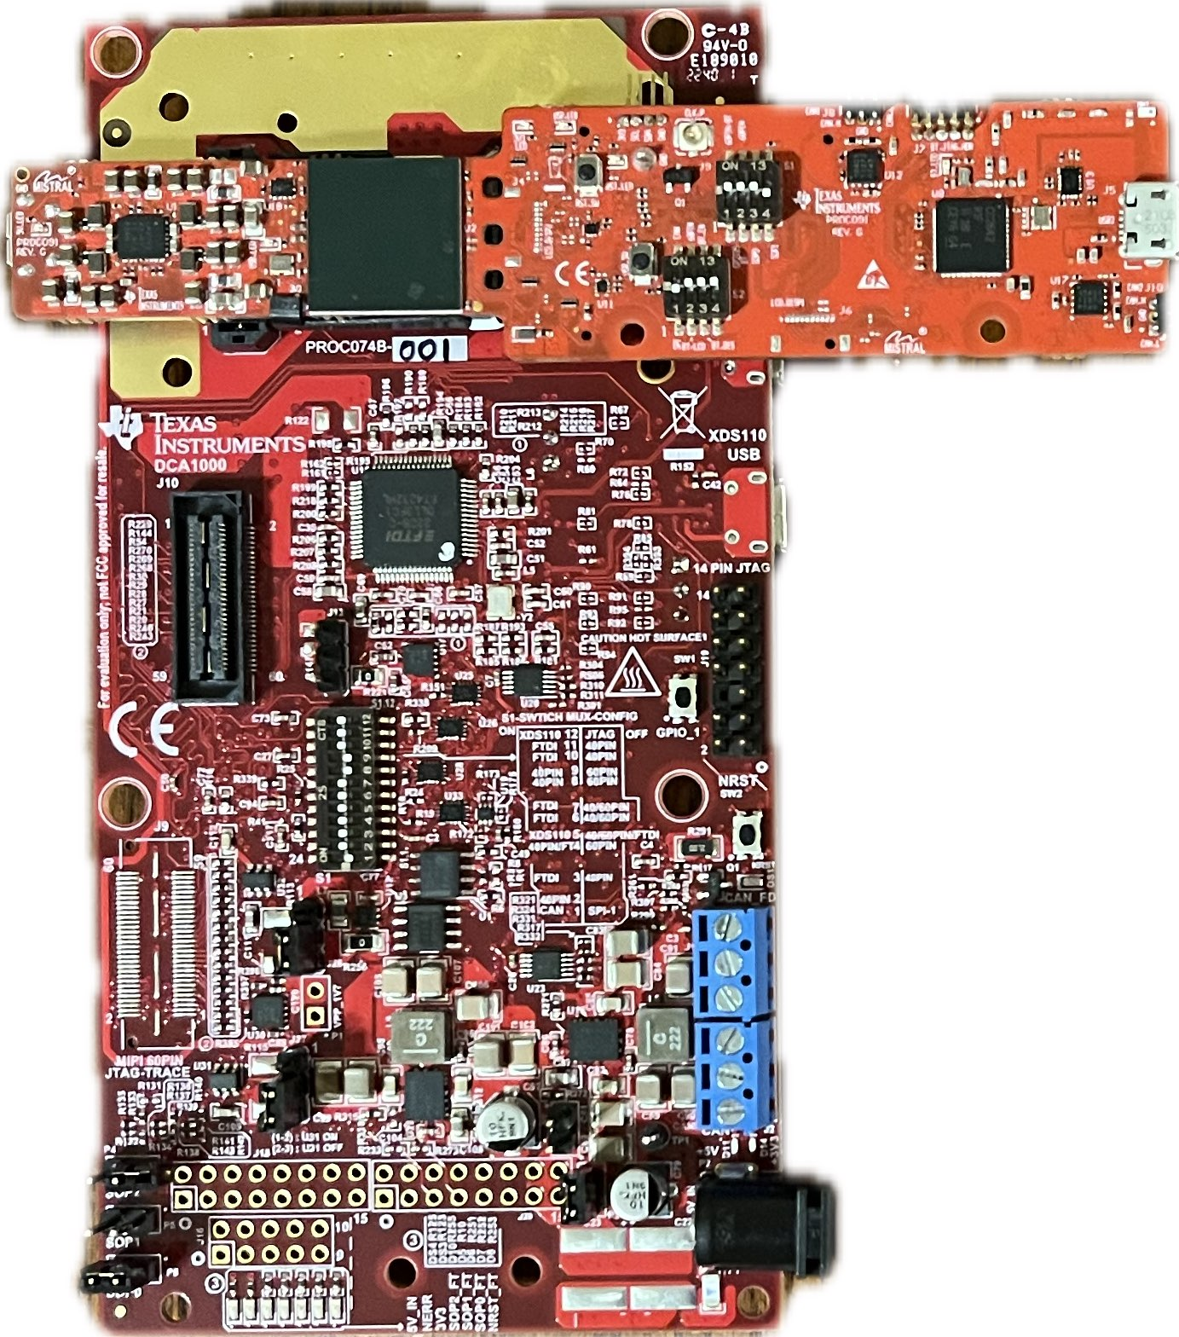
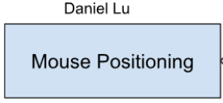
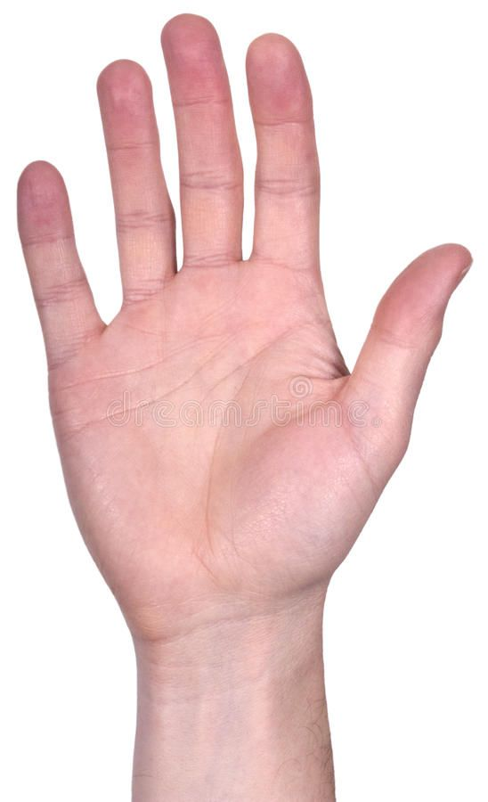


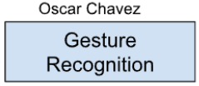
Chirp Config / Collect Data
Greyson Heath
Accomplishments since 403 <10> hrs | Ongoing progress/problems and plans until the next presentation
<5.5> AutoDesk Inventor Pro - 3D Radar Enclosure Model Prototype <1> Sponsor Meeting Review <3.5> Python GUI R&D | Meet with sponsor to discuss potential thermal conductivity concerns with radar enclosure case Solidify Python GUI

Slide 7
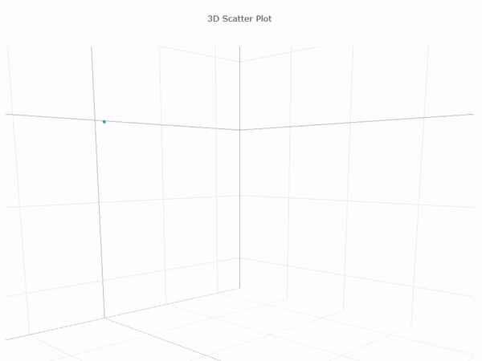
Hand Tracking on Pointer Radar

Slide 8
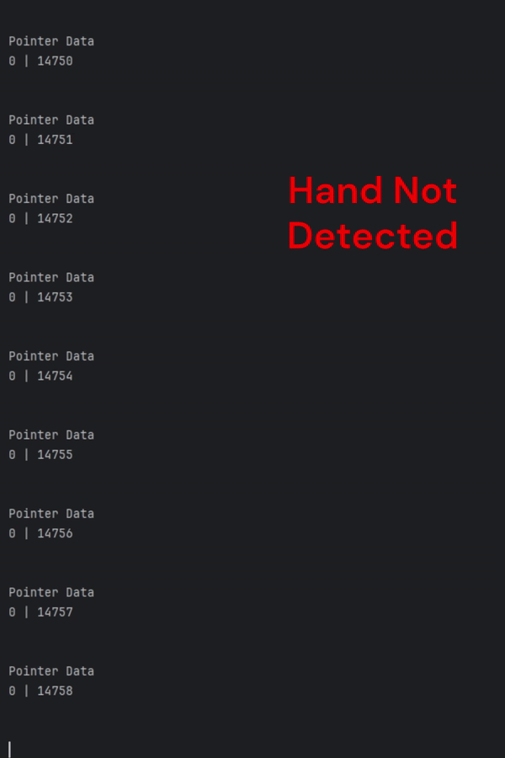
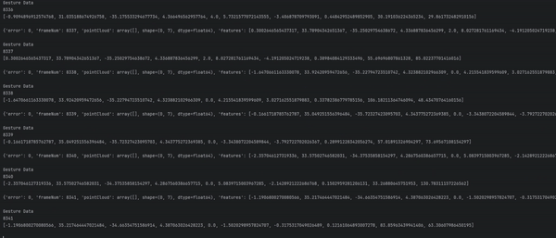
Terminal Output
Mouse Positioning Data
Gesture Data
Pointer Data
[# Points] | [Frame #]
Point 1: [X, Y, Z]
Point 2: [X, Y, Z]
…
Gesture Data
[Frame #]
Features: [size 10]
…
Notes:
Pointer Data: X, Y, Z, doppler, SNR, noise
Gesture Data: Weighted doppler, range, elevationMean, AzimuthMean

Slide 9
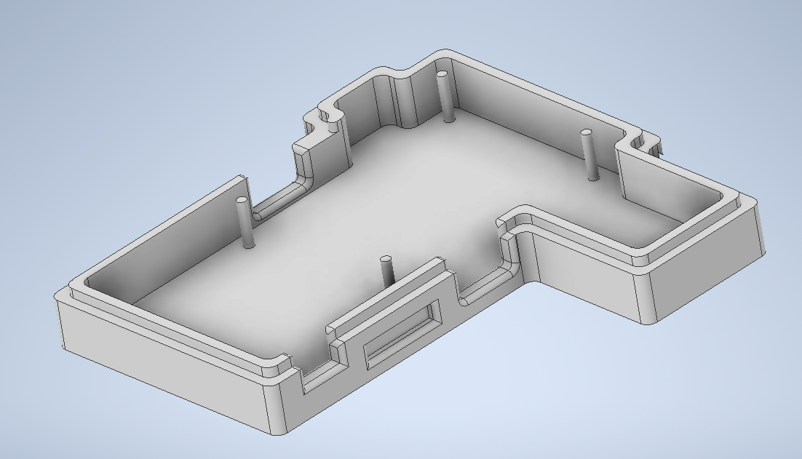
Radar Enclosure Case (Bottom)
Notes:
Autodesk Inventor Pro

Slide 10
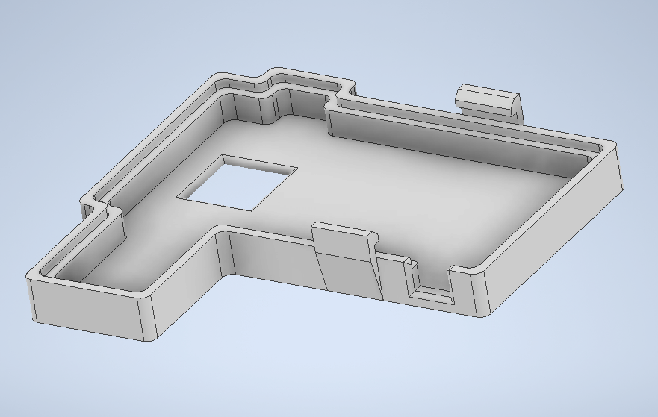
Radar Enclosure Case (Top)

Slide 11
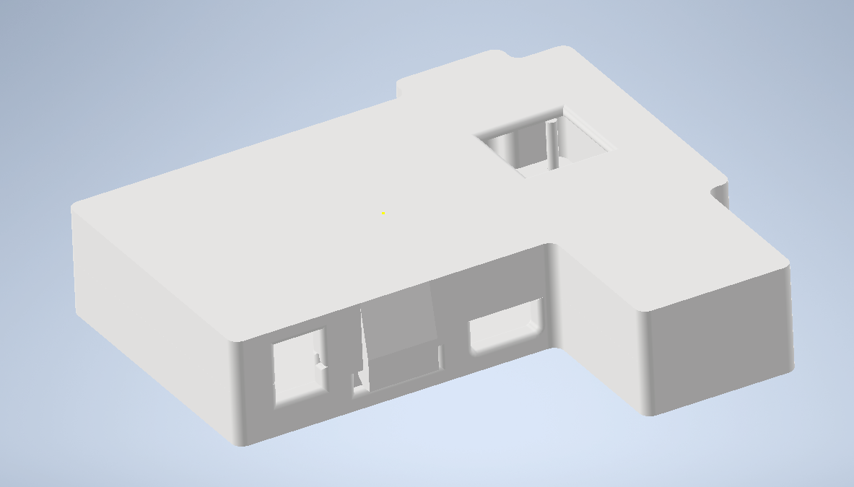
Radar Enclosure Case (Combined)

Slide 12
-Gesture Recognition-
Oscar Chavez Araiza
Accomplished since 403 <~11> hrs | Ongoing progress/problems and plans until the next presentation
<1> Meeting with sponsor <2> Planning next steps <2> Fixing version problems <6> Fixing integration problems | Problems TI produced demo code using Python 3.8, some members were using Python 3.12. Some packages from v3.8 were not supported by v3.12. ML saved model was not compatible with tensorflow for python 3.12 Progress Version problems have been resolved

Slide 13
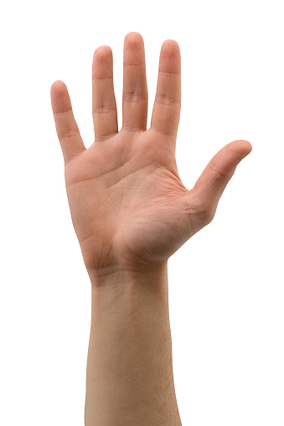
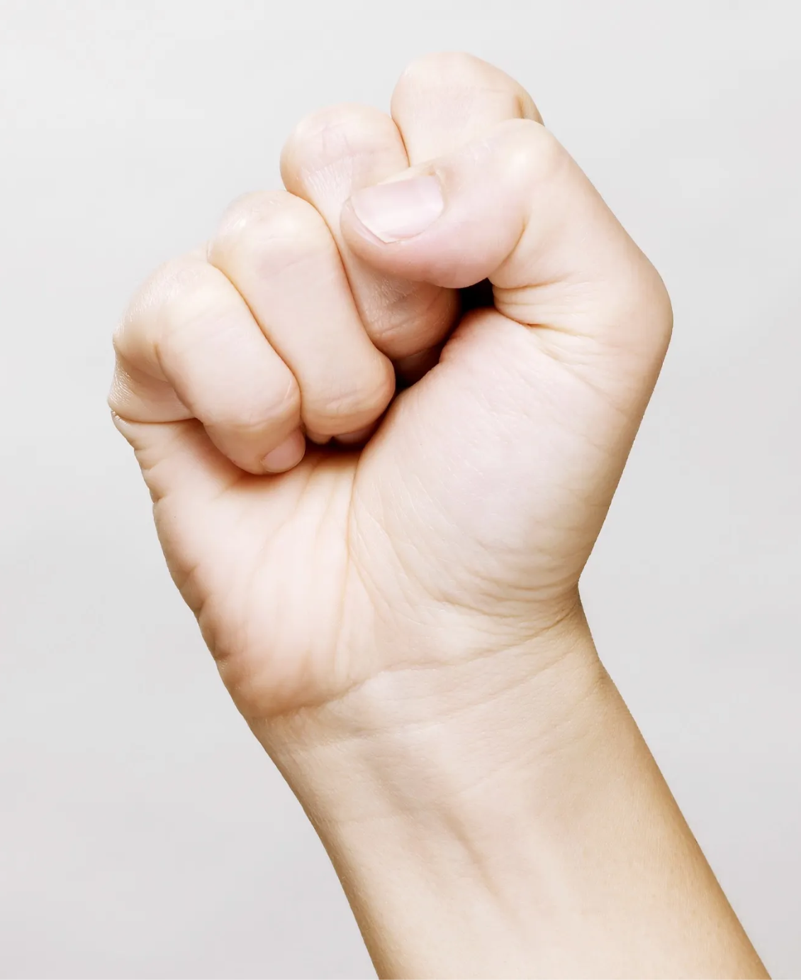
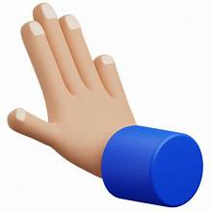

Gesture Recognition
Gesture 1 (L-Clk)
Shine Gesture
Gesture 2 (R-Clk)
Push Gesture

Slide 14
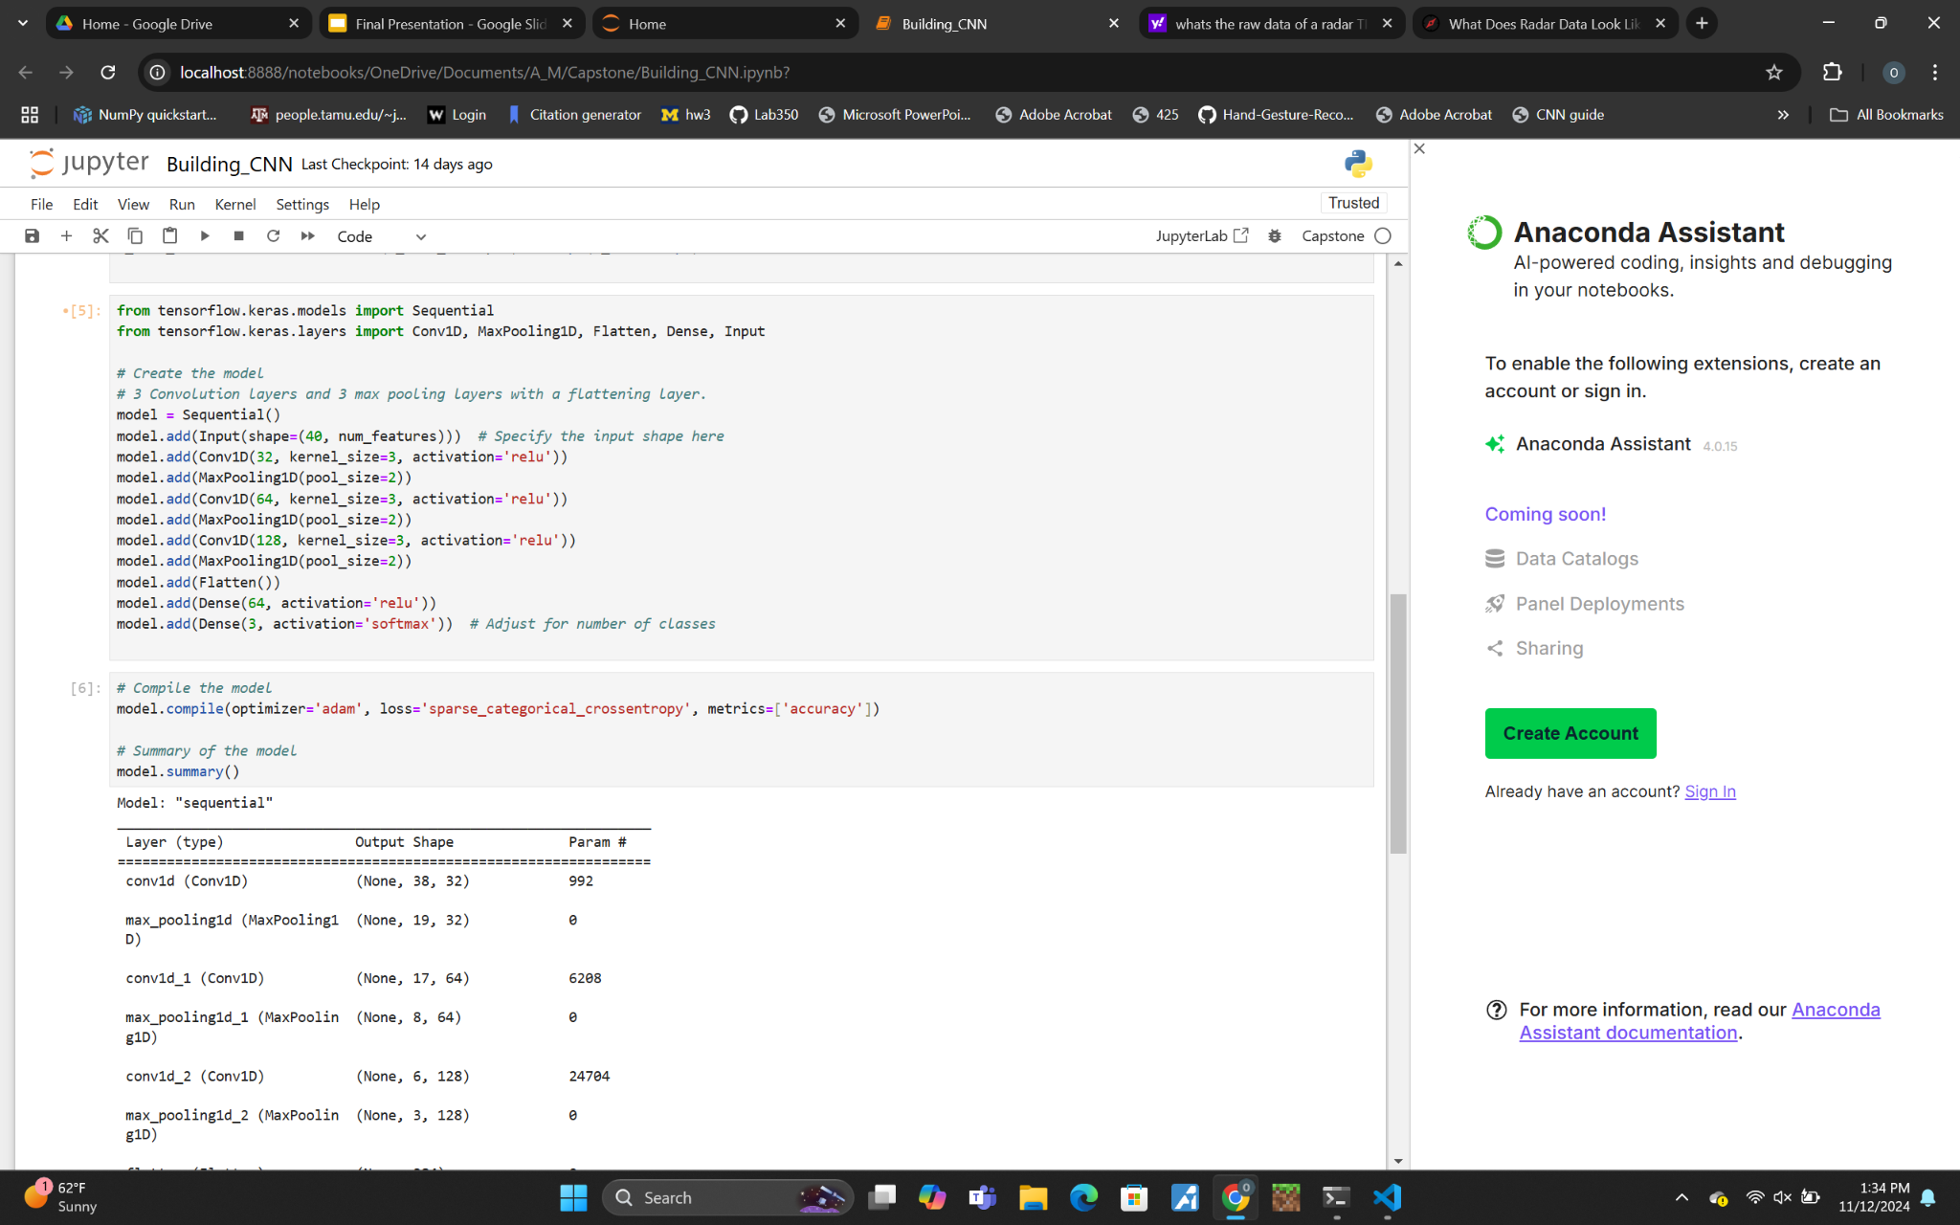
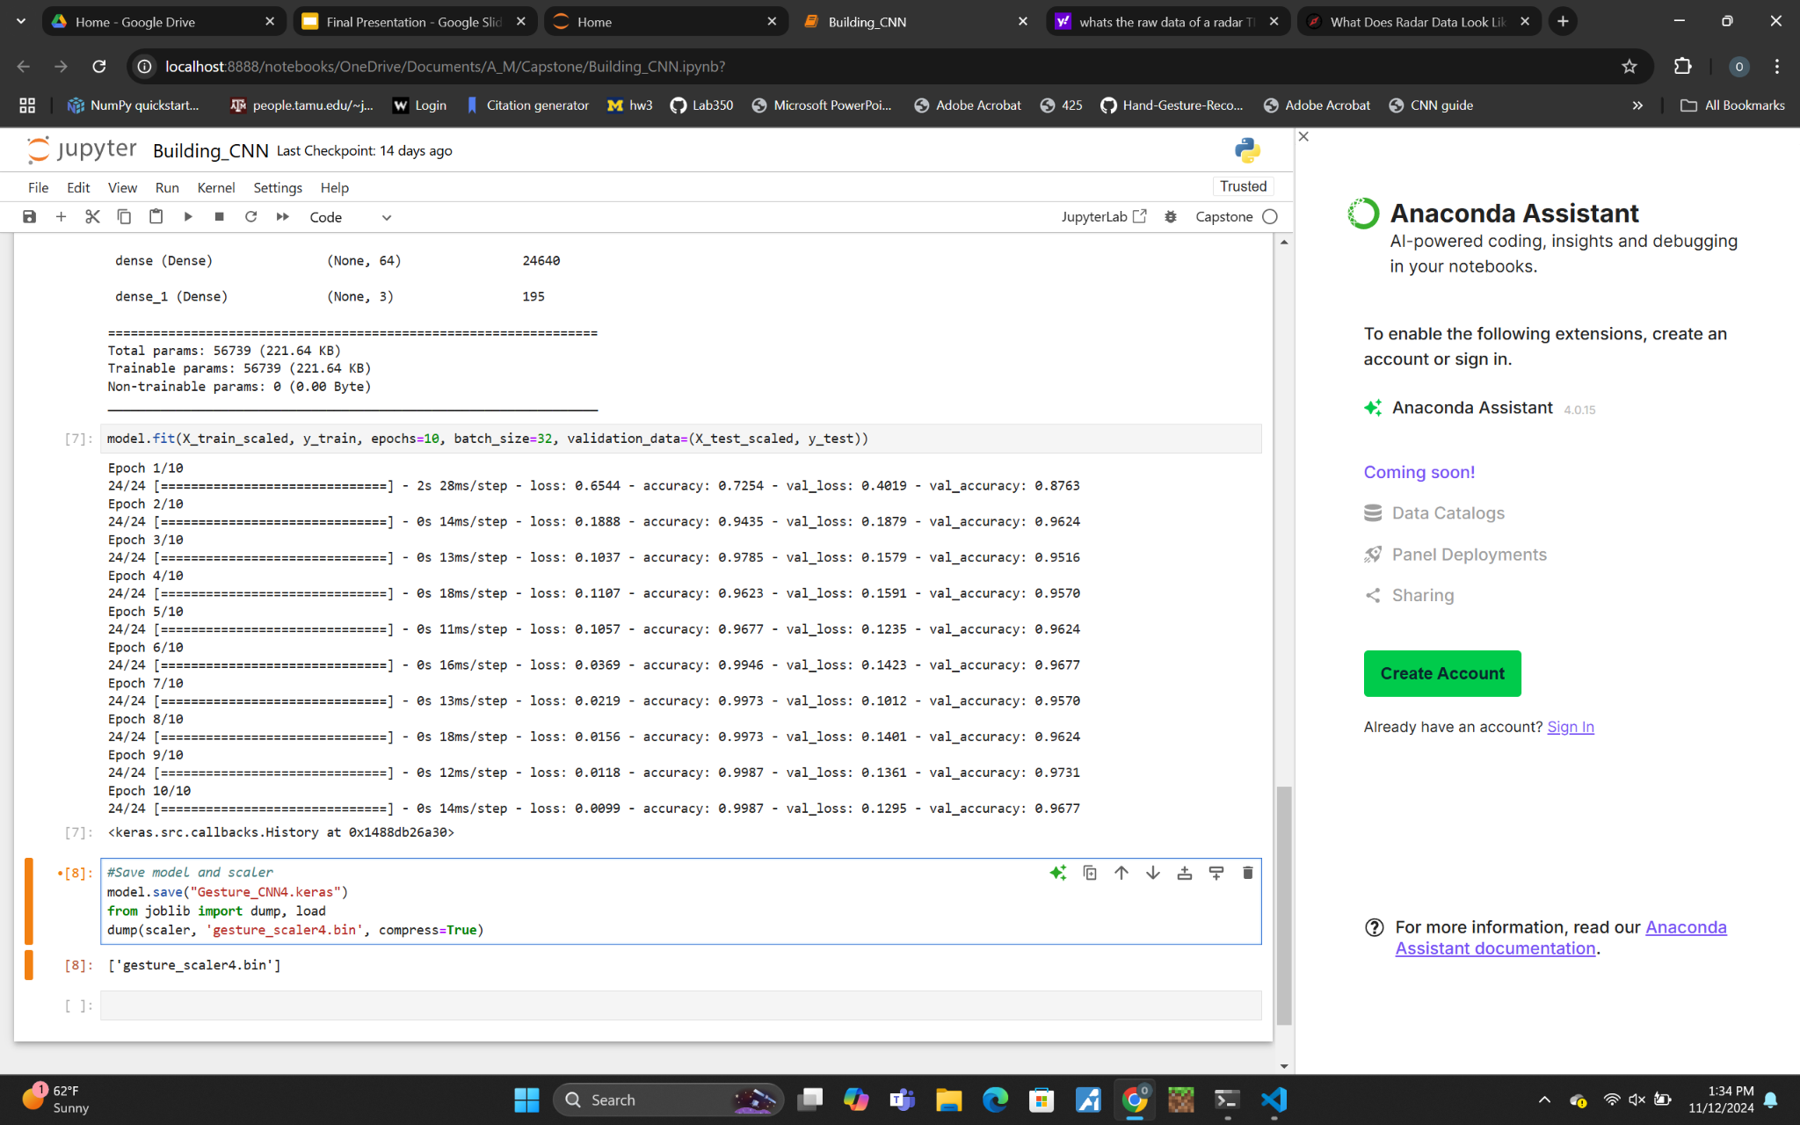
CNN Model
Structure: The model takes 40 frames each with 10 data points.
Layers: 3 Convolutional layers, and 3 max pooling layers.
Test Accuracy: ~ 96.77%

Slide 15
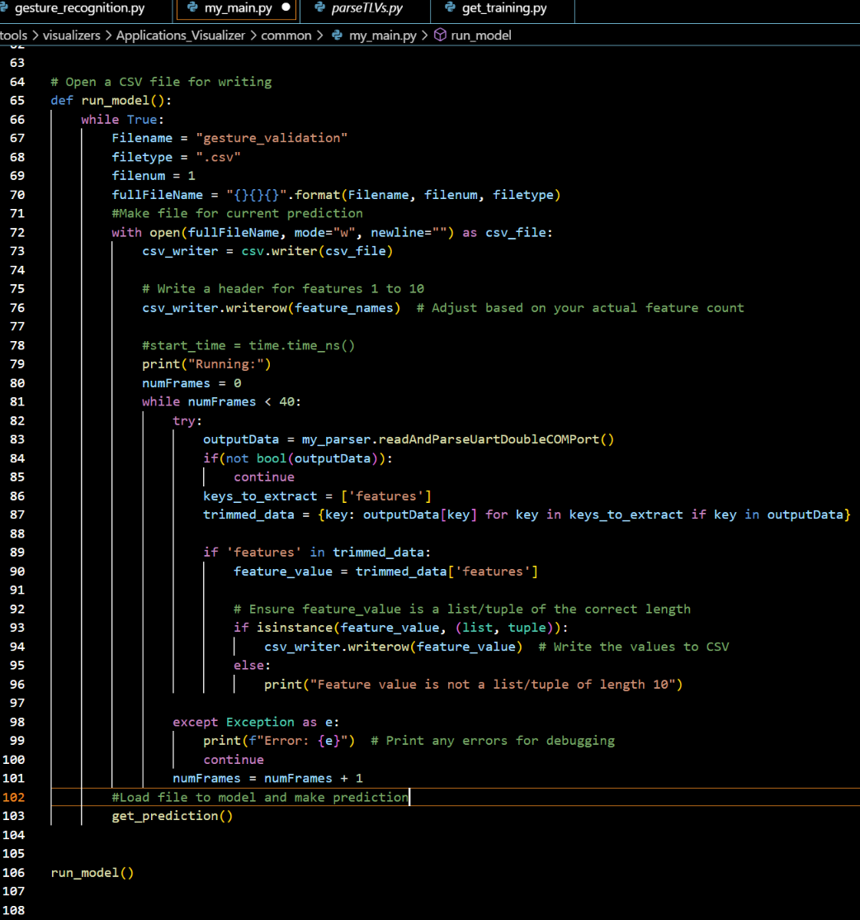
Running Model
This code is used to run the model in real time.
It is currently creating a csv file and loading that into the model. For future implementation it will directly create a DataFrame.
Final implementation will fill the first 40 frames and run the model prediction every 10* frames. (* - true value to be determined)
It takes about 1.4 seconds to capture 40 frames. (Negligible time to run it through the model)

Slide 16
Gesture Positioning
Daniel Lu
Accomplishments since ECEN 403 7 hrs of effect | ECEN 404 ongoing progress/problems in the next 2 weeks
<1>Improve two point cloud modeling demo code for positioning <4> Discussion on how to proceed with integration <1> Decided on final approach to integration with sponsor <1> research into how to turn the demo code into function and loop | Combine the demo with Gesture Recognition demo Generate real moving path of a gesture and test Improve the accuracy of path 1. error background objects 2. gesture shaking 3. time delay

Slide 17
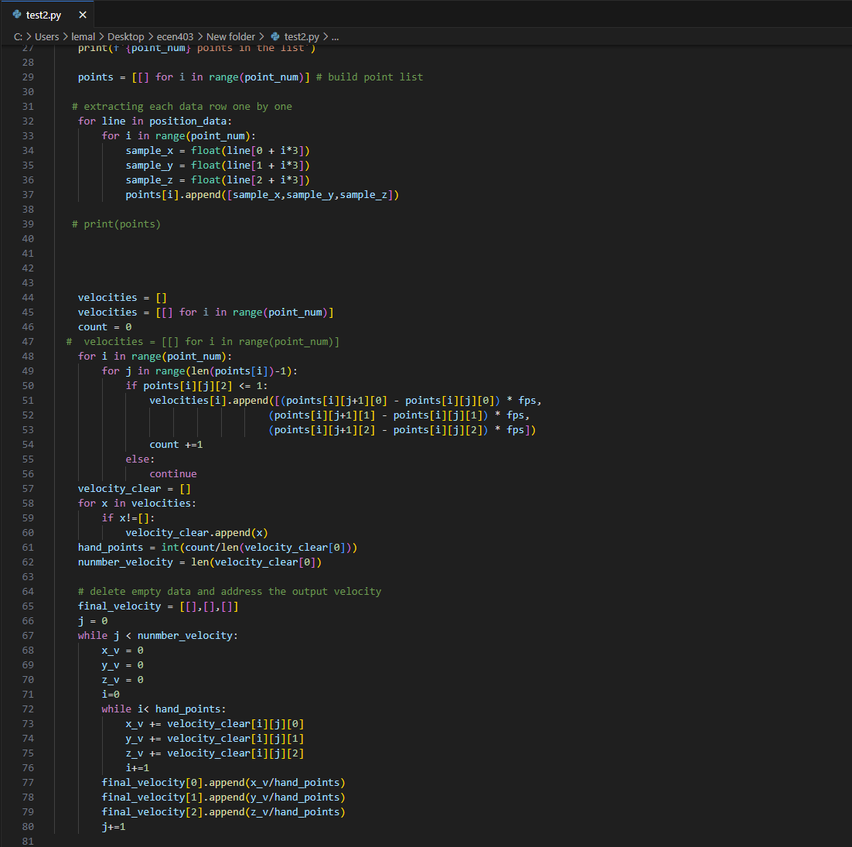
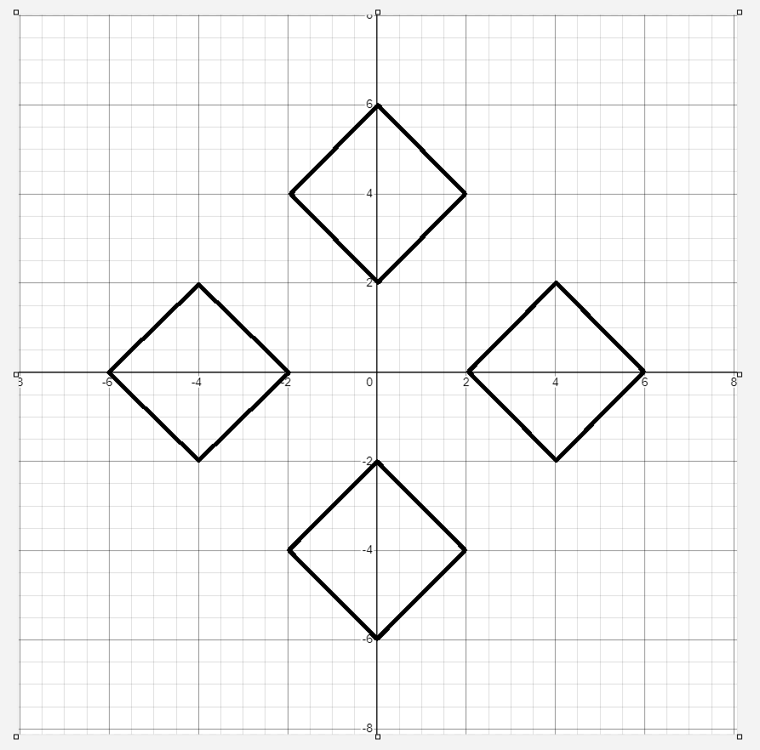
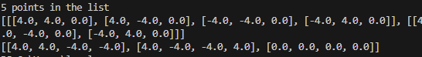
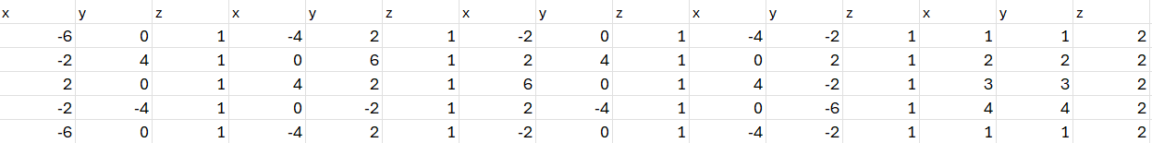

Slide 18
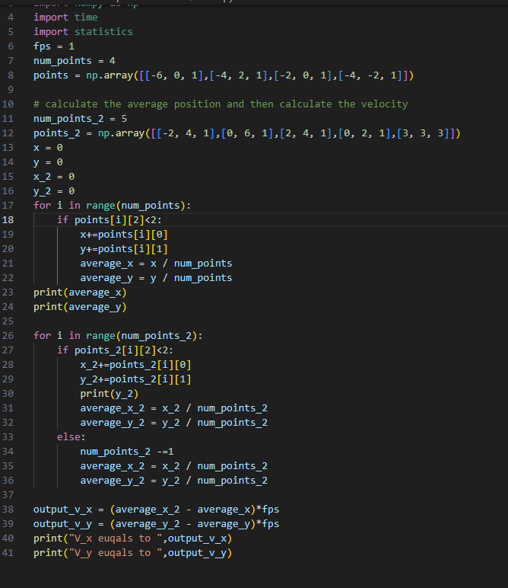
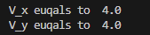

Slide 19
Input Mapping
Zane Meikle
Accomplishments since the last presentation <8> hours | Ongoing progress/problems and plans until the next presentation
<4> Discussion on how to proceed with integration <1> Decided on final approach to integration with sponsor <2> Working on integrating current code <1> research into how to parallelize in Python | Problems: Issues with python versions and integrating the code. Ongoing Progress: Working on integrating code and researching parallel processing for Python Plans: Get a minimum viable product completed from the existing code.

Slide 20
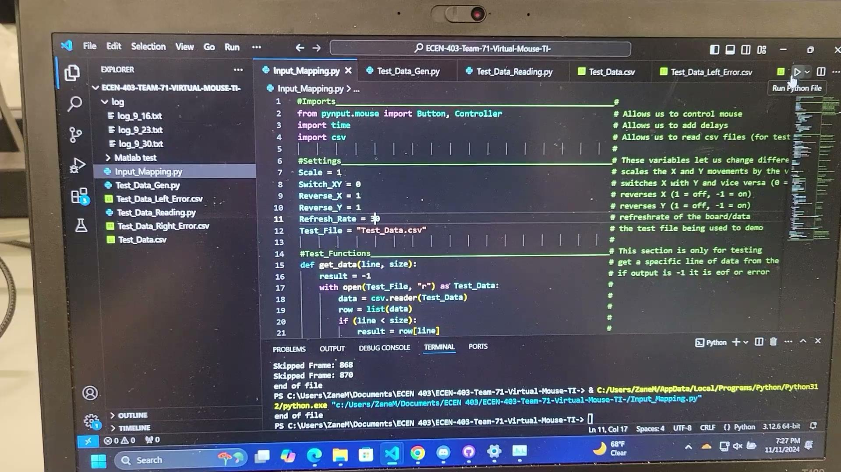
Mouse Movements and Actions

Slide 21
Parts Ordering Status
We do not need any new parts as such we haven’t ordered any.

Slide 22
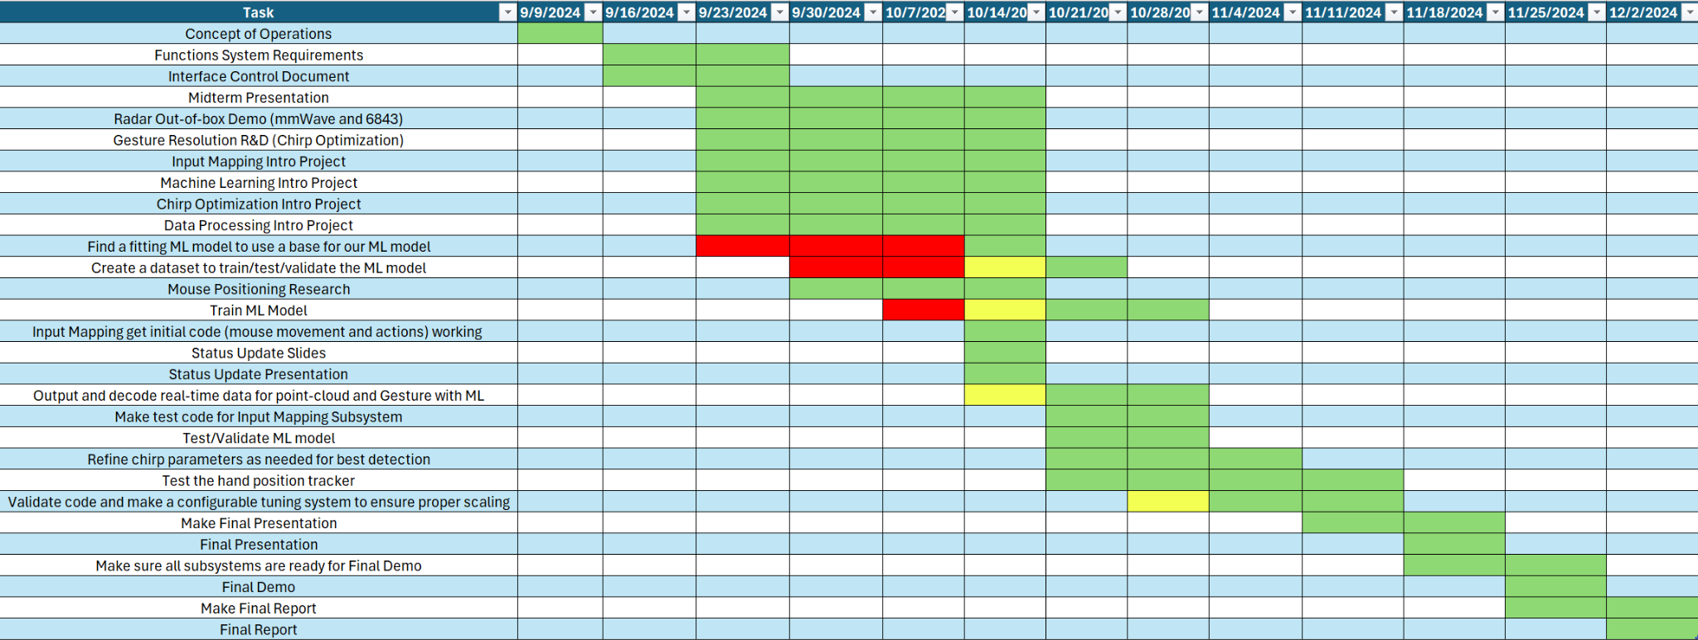
Execution Plan Gantt Chart

Slide 23
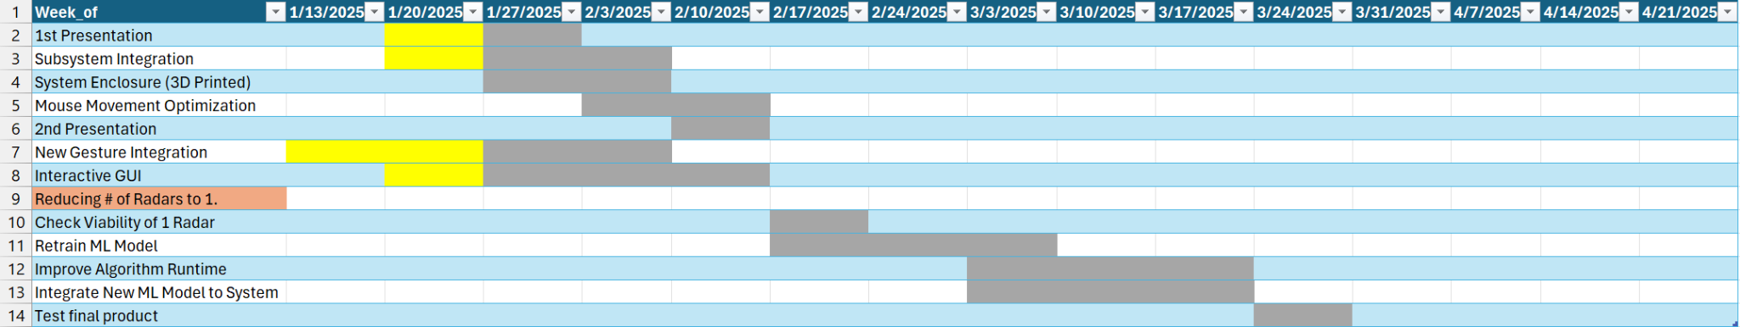
Execution Plan Gantt Chart

Slide 24
Validation Plan
Section | Task | Specification | Result | Owner
3.2.1.6 | Mouse Movement | Mouse can be moved to all corners of the screen by the program. | Passed | Zane
3.2.1.6 | Mouse Actions | The program must be able to right click and left click. | Passed | Zane
3.2.5.2 | Mouse Input Error Handling | The program must properly handle all invalid inputs. | Passed | Zane
3.2.1.4 3.2.1.6 | Gesture positioning | The coordinates of the gesture should be calculated when deleting the error points. | Passed | Daniel
3.2.1.6 3.2.1.8 3.2.3.2.1 | Velocity accuracy | The output velocity of the moving gesture should not have errors. | Passed | Daniel
3.2.1.5 | Hand Gesture Recognition | ML model can recognize the users hand gestures | Passed | Oscar

Slide 25
Validation Plan
Section | Task | Specification | Result | Owner
3.2.1.5 | Gesture Recognition Accuracy | ML model can correctly identify and categorize hand gestures at least 90% of the time. | Passed | Oscar
3.2.1.7 | Functional Radar System | The IWR6843AOPEVMs, and MMWAVEICBOOSTs all properly communicate with the computer and transmit data. | Passed | Greyson
3.2.1.8 | Data Decoding | The python script accurately decodes the TLV data seen from both radars. | Passed | Greyson
3.2.1.3 3.2.1.4 | Radar Angle and Distance | The radars can capture gestures and pointer positions within a 90 degree range up to 1.5 feet | Passed | Greyson
3.2.1.5 | Hand Size | Radar will recognize gestures regardless of hand size. | Passed | Oscar

Slide 26
That is all, thank you.

